Slide 1

Initial Results
10/11/2022
Capstone: Fall 2022
Inside Airbnb - Housing Analysis
Team 1: Venkata Naga Sai Kumar Bysani, Nandita Krishnan, Feisheng Qin, Brett Sexton, Vishwa Srivastava

Slide 2
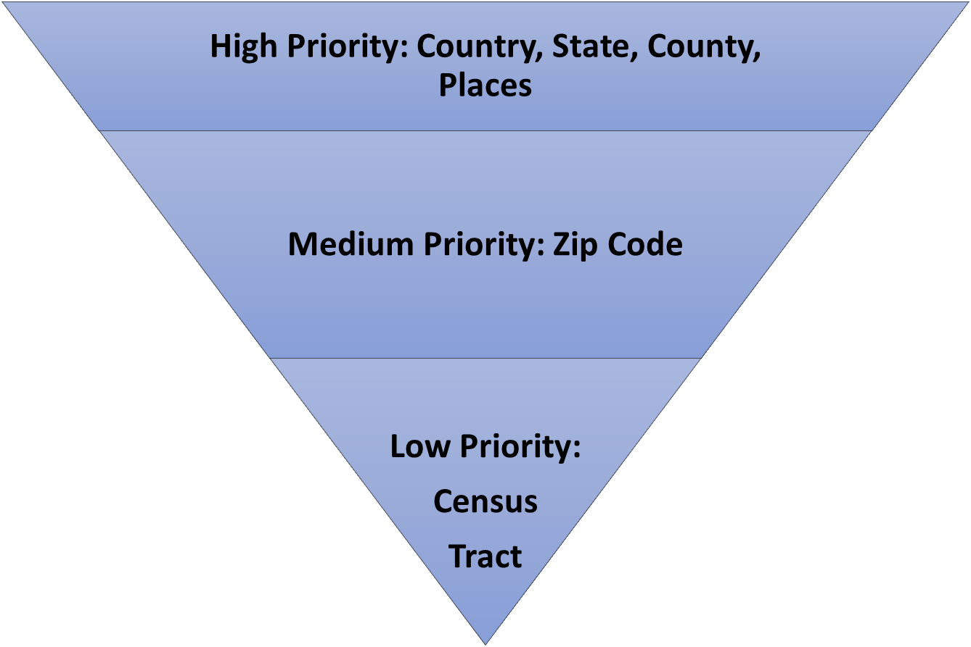
Progress with Geocoding and Listing Labeling
We have gone more granular and have been successful with geocoding.

Slide 3
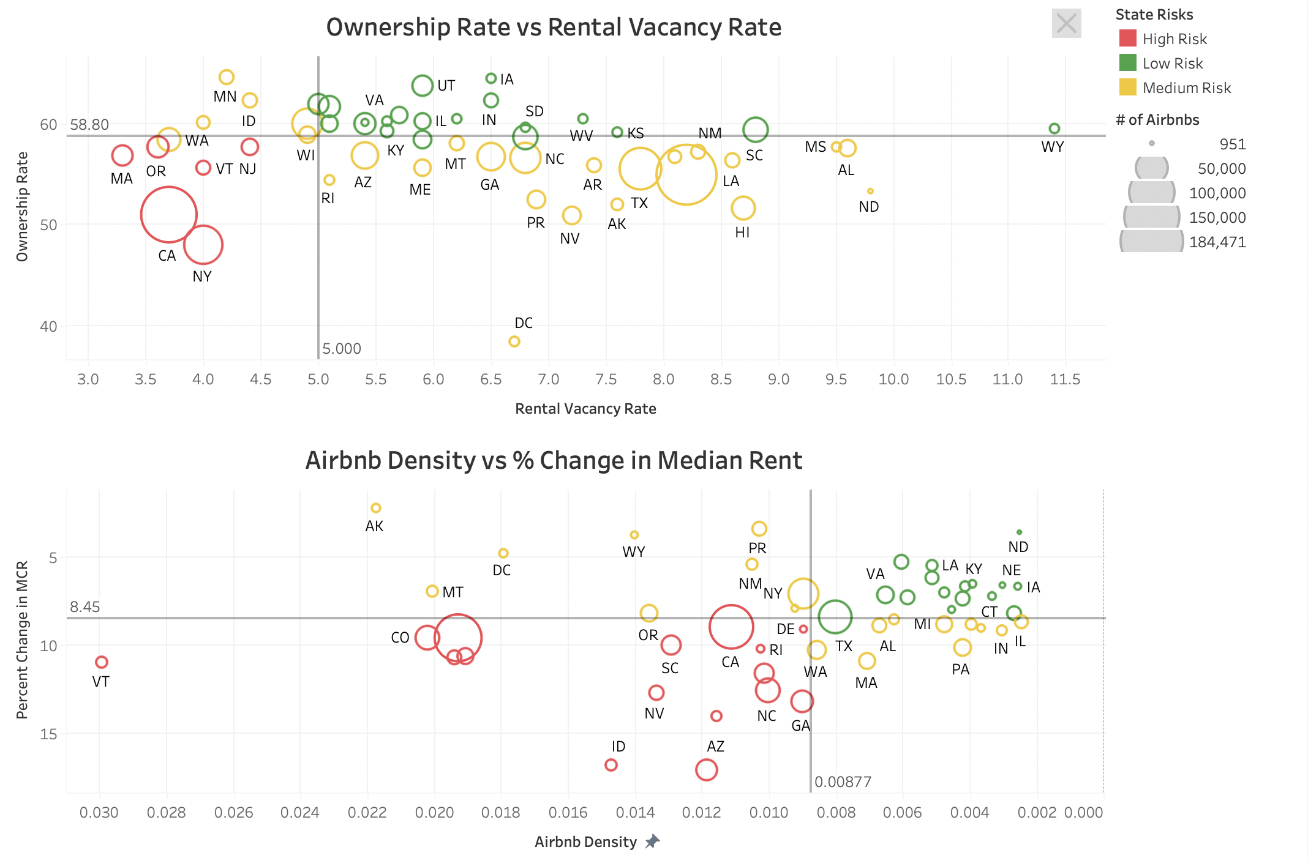
Testing our Hypothesis of Risk Components on States
Takeaway Box:

Slide 4
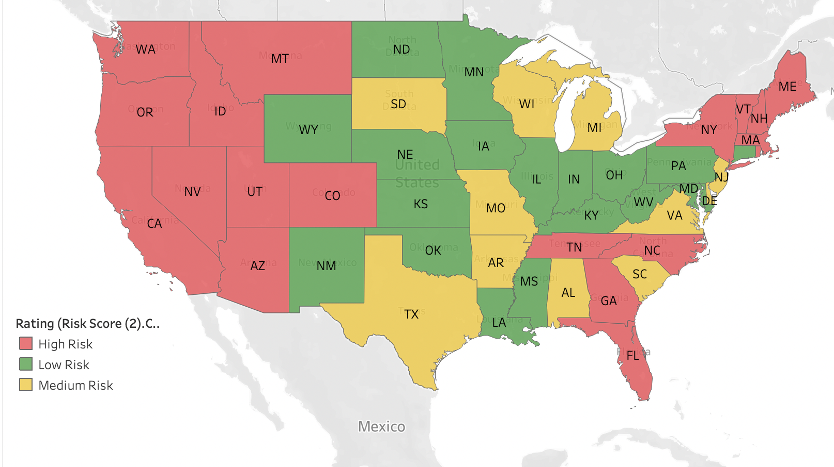
Mapping High, Medium, and Low Risk States
Takeaway Box:

